Slide 1
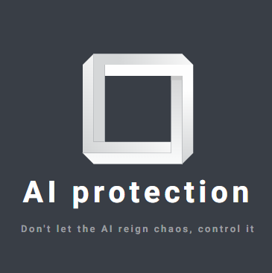
AI Protection/security
Created by Rafi Tsigarov № 2201261077

Slide 2
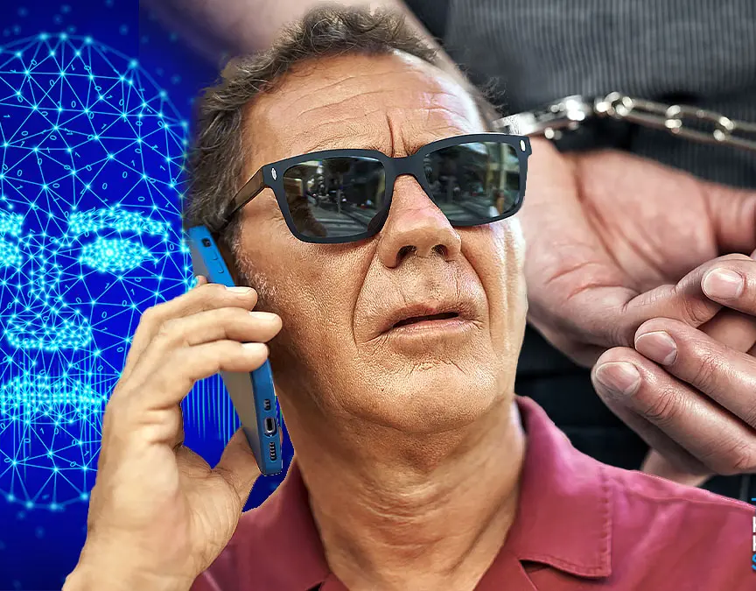
why is this start-up necessary?
As you have noticed since two months ago, AI can now imitate other people's voices almost perfectly. This unique opportunity is used for phone scams and threats, at least for now, these are the most frequently used cases.

Slide 3

what benefits will there be for potential stakeholders?
The benefits of this AI technology will be to protect them from AI fraud in the future. Like phone scams and voice confirmations from strangers.

Slide 4
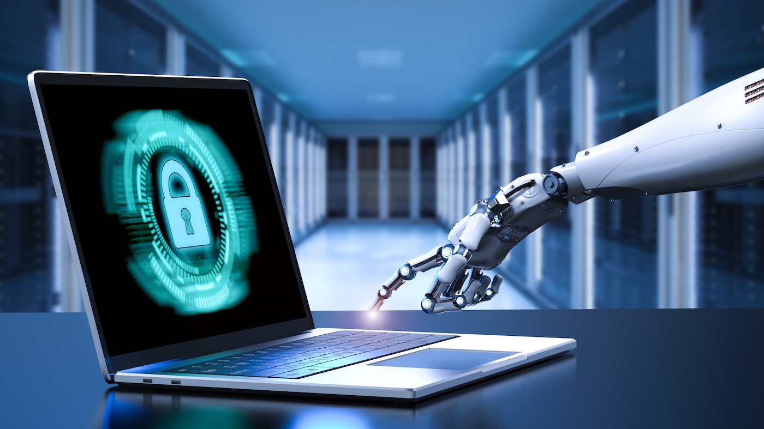
why should this idea be even taken into account?
It is important to start making AI that recognizes AI attacks and stops them or at least warns us in time. Recognizing near-perfect AI voice imitations is not overwhelming for humans, and that's why we need AI applications to help us recognize fake attacks.

Slide 5
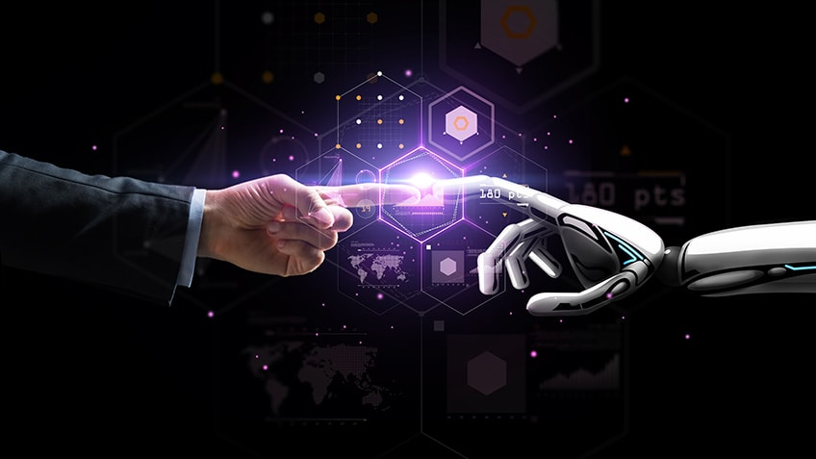
what makes you different from other competitors?
Our company differs from others with the idea of ​​making quality and well-tested AI that is at least 80 percent usable. Most companies make their products in a very short time, but do not test them enough for serious problems that may arise.

Slide 6
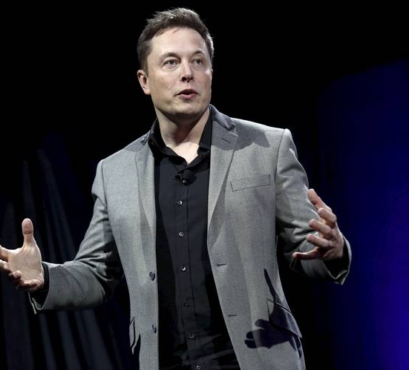

what forms of budgeting will you have – where will the resources for establishing this start-up come from?
Tradewindfinance is a site that helps develop new business companies by giving them the resources they need to start.
For resources and budget, I can present my idea for a company to Elon Musk who supports ideas that have great potential.

Slide 7
how many employees would you need?
I will need only 7 people to start the company. Four will develop the AI ​​itself, and the other three will work on implementing the Windows platform. Over time, as we add new extras and on more platforms, the team will get bigger and bigger.

Slide 8


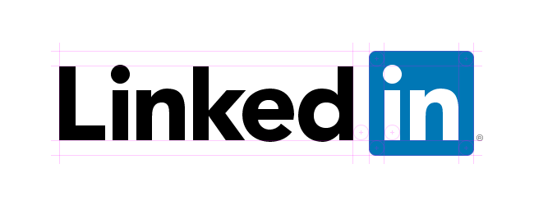

what sites could you use in order to look for employees?
To search for workers, I would use sites such as Jobs.bg, Dev.bg, LinkedIn, Zaplata.bg

Slide 9




what kind of technologies will you be using in order to enhance the work?
The Pycharm professional application will be used to create the AI. Programming language Python and for database Azure SQL Database.
For a platform at work we will use GitHub.

Slide 10
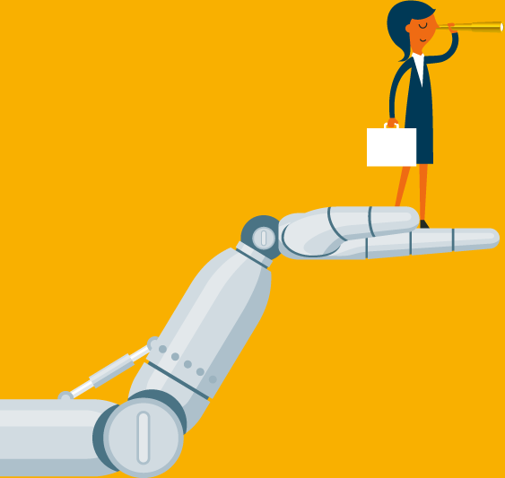
what are the long-term goals of this start-up?
The long term goal of this company is to keep improving their AI and be able to counter new ways of fraud through AI and be available on all platforms.

Slide 11


